Slide 1
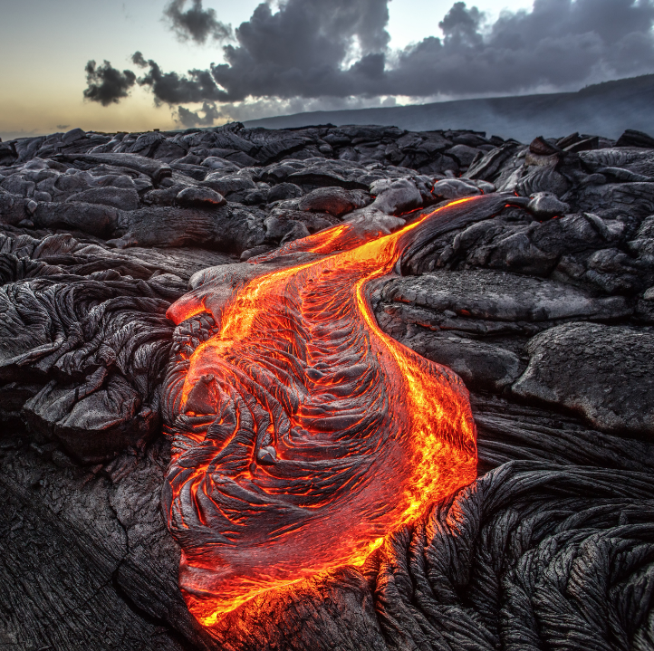
Igneous Rocks
Igneous is the Latin word for FIRE
Notes:
Fresh lava flows over an old lava field in Hawaii.

Slide 2
Igneous Rocks
Igneous rocks are very hard and contain crystals
The size of the crystals depend on how long it took to cool down
Igneous rocks never contain fossils

Slide 3
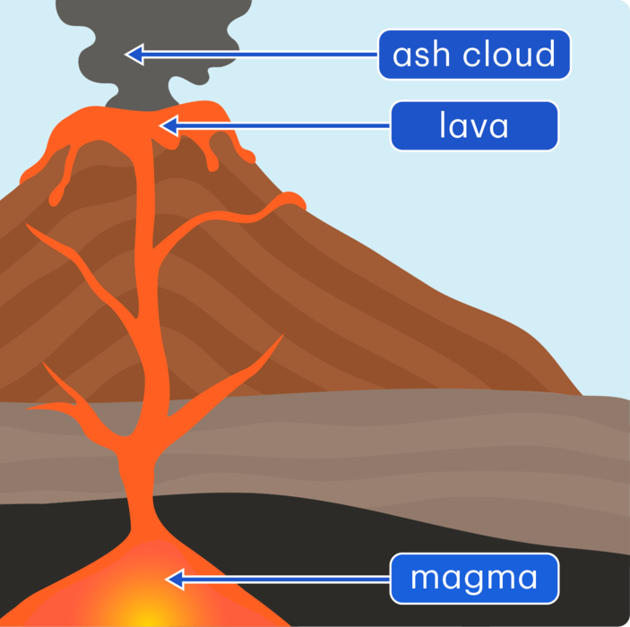
Igneous Rocks
Magma: Melted rock below the surface
Lava: Melted rock above the surface from a volcanic eruption
Notes:
Deep below the Earth's surface, temperatures are high enough for rock to melt. While it is below the surface, molten rock is called magma. When magma rises to the surface in a volcanic eruption, it is called lava.

Slide 4
Examples of Igneous rocks
Notes:
Examples of igneous rock (left to right): diorite (intrusive), pumice (extrusive) and granite (intrusive).

Slide 5
Activity:
 | Your task: Put the sentences in order of how igneous rocks are formed. |  |  | Lava (Magma at the surface) cools quickly. It makes igneous rock with small crystals.
1. | A. Inside the Earth is magma. This is very hot molten rock. |  |  | The magma comes to the surface only when the tectonic plates diverge (move apart) or the volcano erupts.
 | It makes igneous rocks with large crystals. |  |  | Some magma does not get to the surface.
 | It cools slowly underground. |  |  | The magma that does come to the surface causes uplift of the ground at a divergent plate boundary or a volcano.

Slide 6
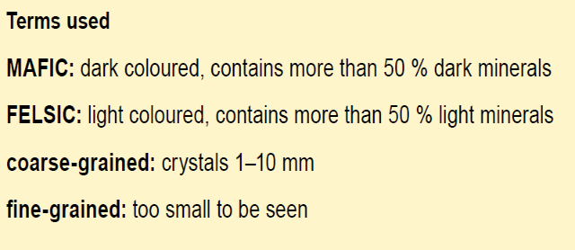
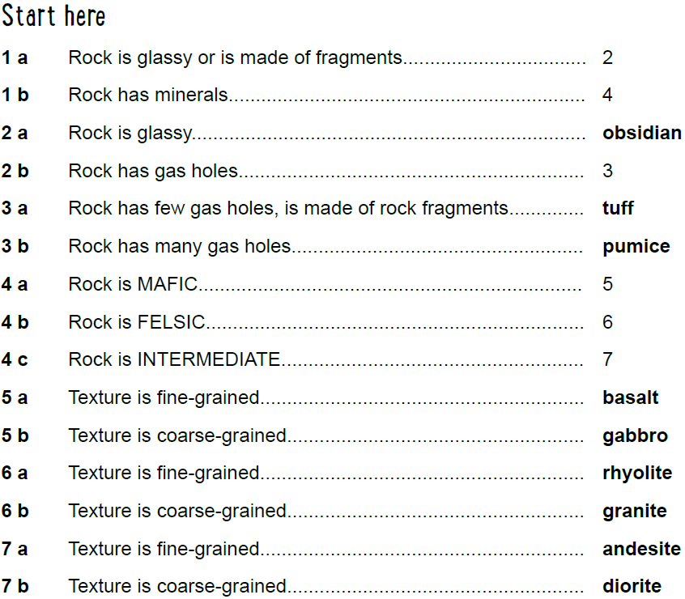
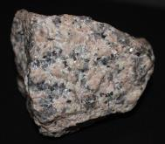
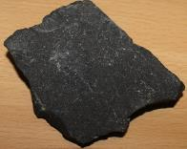
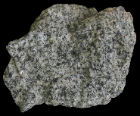
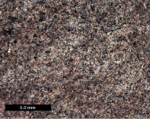
Dichotomous Key to identify properties of Igneous Rocks

Slide 7
Plenary: Quick Quiz
Q1) Which of these is an example of igneous rock?
Limestone
Granite
Marble

Slide 8
Plenary: Quick Quiz
Q2) Which of these is an example of igneous rock?
Sandstone
Slate
Pumice

Slide 9
Plenary: Quick Quiz
Q3) Which of these is an example of igneous rock?
Obsidian
Chalk
Clay

Slide 10
Plenary: Quick Quiz
Q4) How are igneous rocks with LARGE crystals made?
When magma cools slowly under ground and forms large crystals.
When lava cools quickly over ground and forms large crystals.
When lava cools slowly over ground and forms large crystals.

Slide 11
Plenary: Quick Quiz
Q4) How are igneous rocks with SMALL crystals made?
When magma cools slowly under ground and forms small crystals.
When lava cools quickly over ground and forms small crystals.
When lava cools slowly over ground and forms small crystals.

